Slide 1
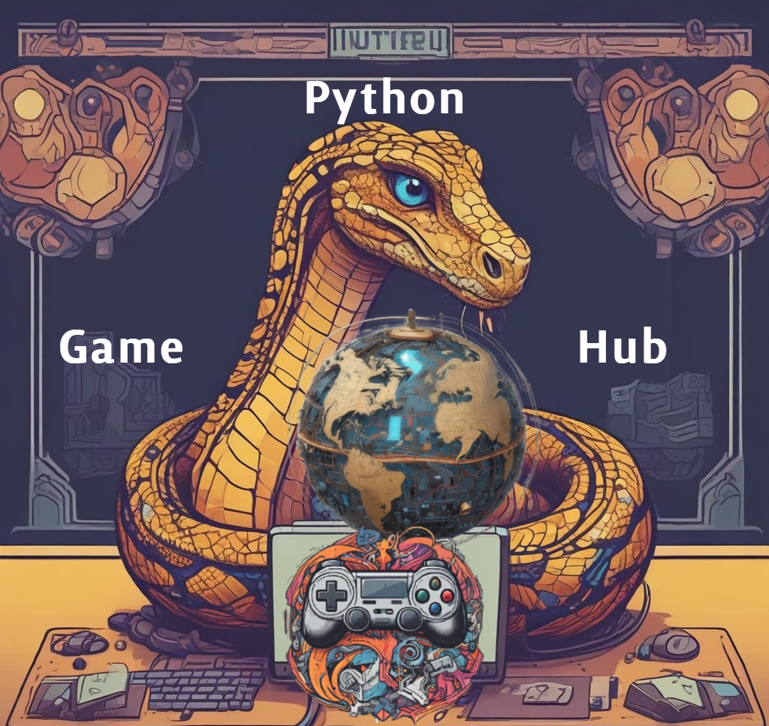

Python Game Hub
Presentation
Victoria Lee
James Mutry
Todasha Foster
Dajin Chung
Javon Payne
Oluwatumininu Ipaye
CMSC 495 Capstone Project:
(Group 1)
5/3/2025
Notes:
You must include an audio, only (mp3/wav files!).
How to add audio to Google Sldies: https://www.youtube.com/watch?v=EF-omQKwELY
Here is an online voice recorder: https://www.rev.com/onlinevoicerecorder
Here is how to upload an audio file to google drive: https://www.youtube.com/watch?v=CyOQ88abZQo
Here is another online voice recorder:
https://online-voice-recorder.com/#google_vignette
If you choose to use**iphone/android** voice recorder you must **convert the files** to mp3/wav files! Link to add Converted Audio to Google Slides: https://docs.google.com/presentation/d/16eH4TWDz6JfaBCtxRwTp7j5-nHjiidNZw56YX9pxD6g/htmlpresent
Make sure to make it very briefly and add some images/emojis if possible! **Note:** every team member must paste the google slides and google slides video in the unit 8 discussion after I record the video for the whole team.

Slide 2
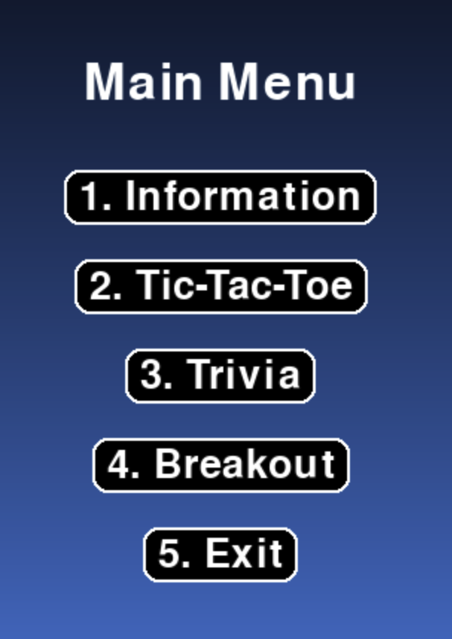
Introduction
Welcome to the Python Game Hub – a multi-game application built in Python using Pygame
Centralized interface featuring:
Tic-Tac-Toe (with AI)
Trivia (with timed responses)
Breakout (arcade-style)
Focused on modular design, replayability, and user-friendly navigation
Developed through collaboration, GitHub version control, and iterative planning

Slide 3
Process Overview
For our Python Game Hub, we built a multi-game application using Python and Pygame, featuring Tic Tac Toe, Trivia, and Breakout, all connected through a central Main Menu. We used modular coding, GitHub for version control, and GitHub Actions for automated testing.
Our main tools were Python 3.9+, PyCharm, VSCode, GitHub, and Excel for manual testing.
Each teammate contributed:
James Mutry developed unit tests for all modules and manual testing.
Victoria Lee handled documentation, UI improvements, GitHub Actions, and debugging support.
Todasha Foster built the Main Menu, worked on Breakout and Trivia improvements.
Javon Payne helped create the Main Menu and developed the Trivia game.
Oluwatumininu Ipaye built the Breakout game with full physics and scoring.
Dajin Chung developed the Tic Tac Toe game, including the AI logic, and assisted debugging for Trivia and Breakout.
Strong collaboration and clear task ownership helped us create a polished, fully tested application.

Slide 4
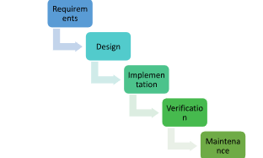
Project Plans
Other Plans:
Unit 4: Phase 1 Source Report Plan
[Google Drive (Docx) Link]
[GitHub (doc) Link]
Unit 5: Testing Plan
[Google Drive (Docx) Link]
[GitHub (doc) Link]
Unit 6: Phase 2 Source Report Plan
[Google Drive (Docx) Link]
[GitHub (doc) Link]
Unit 7: User Guide
[Google Drive (Docx) Link]
[GitHub (doc) Link]
Unit 8: Deployment Report
[Google Drive (Docx) Link]
Project Plans:
Unit 2: Project Plan
[Google Drive (Docx) Link]
[GitHub (doc) Link]
Unit 3: Project Design Plan
[Google Drive (Docx) Link]
[GitHub (doc) Link]
Figure: This image below represents the plans for our team using the SDLC waterfall method
Notes:
Now, in this slide I’ll discuss the Documentation and Plans. For the first three weeks, the Project Plan and Design Plan were essential in our Python Game Hub project as they provided a clear roadmap and structure, helping the team stay organized, meet deadlines, and ensure all features were well thought out before coding began. This includes a breakdown of our SDLC waterfall method, milestones, tasks, issues, overall progress, and job contributions. The development phases (Phase 1 and Phase 2) ensured all core and advanced features were implemented and refined. The Testing plan tested that all games work, while the User Guide made the project accessible for users. Finally, the Deployment Report and Presentation ensured everything was ready, for the final submission.
Note: If you want to view the updated project plan which has the testing, git (version control), chart and timeline is is crucial to view all the appendixes of Units 4, 5, 6, and 8.
On the left has the links to all the project plans and on the right has the link to all the other project plans.

Slide 5
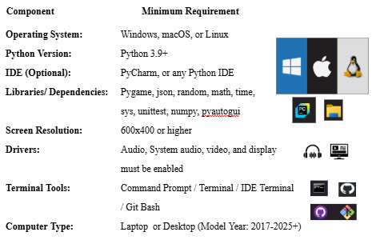
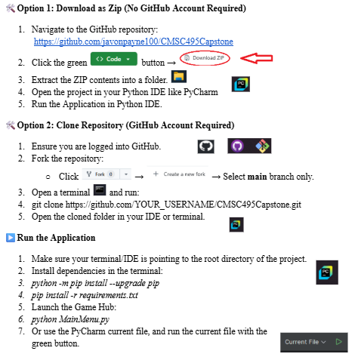
Requirements and System Specification
Functional Requirements
Main Menu Navigation: Users will be able to easily navigate the main menu and select any game to play.
Session Control: Users will be able to restart the game, return to the main menu, or exit after each session.
Outcome Tracking: The system must track and display game outcomes, including winners, losers, ties, scores, and remaining lives.
Non-Functional Requirements
Performance: Games must load within 3 seconds and run smoothly without noticeable lag.
Usability: The interface should be intuitive and user-friendly, accessible to users of all ages.
Reliability: The system must handle all expected inputs and edge cases reliably, with no crashes.
[Functional/Non-Functional Requirements Link Here]
User Guide: [Google Drive (Docx) Link] [GitHub (doc) Link]
Unit 6: [Google Drive (Docx) Link] [GitHub (doc) Link]
Note: Please, Refer to User Guide / Unit 6 to help set up System Requirements and System! (Images to the Right!)

Slide 6

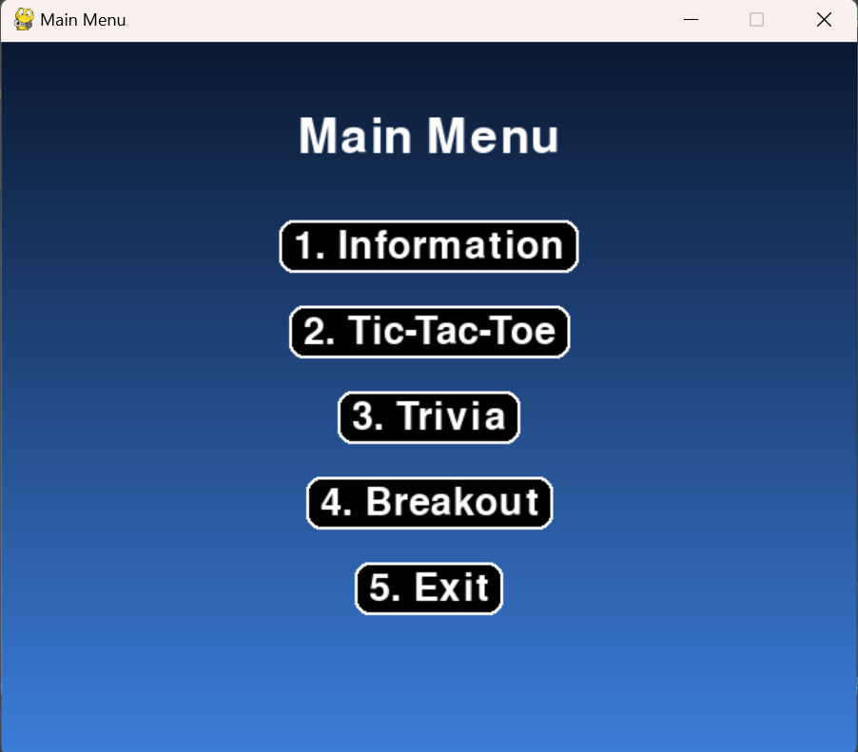
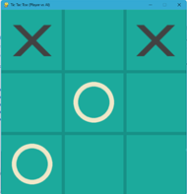
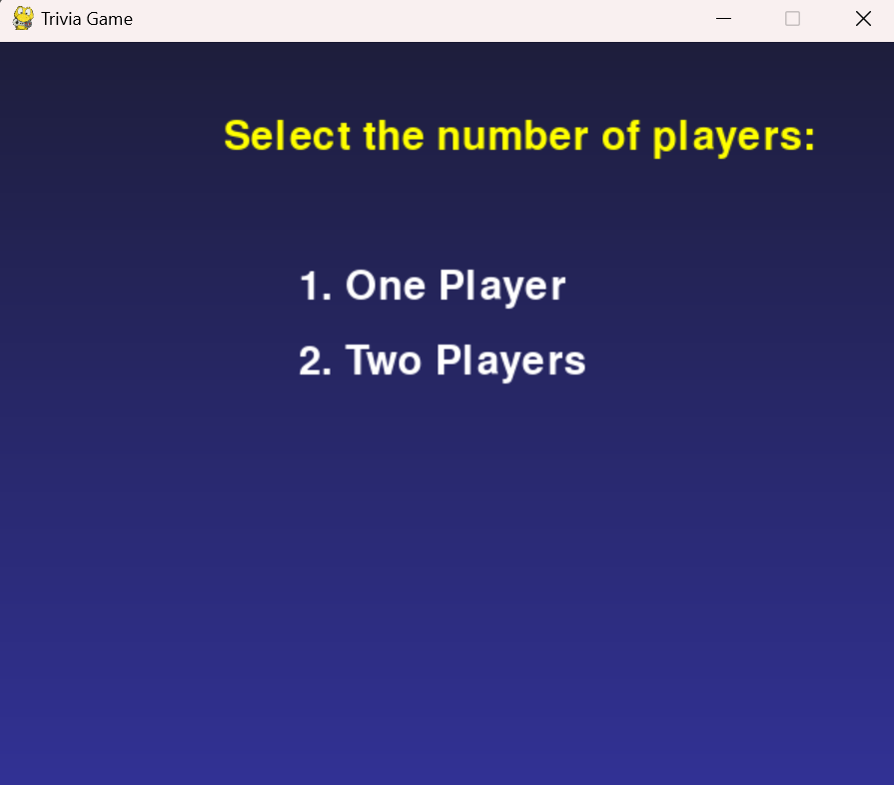
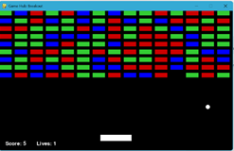
Project Design and User Guide
The Python Game Hub utilizes the Pygame library and is a desktop-based application.
It features three simple games and an information:
Tic-Tac-Toe, Trivia, and Breakout (offline)
Information (online, readme.md on GitHub Repo.)
The major idea behind the project is its design that requires no installation or account setup, allowing it to be used in shared spaces such as schools and libraries.
We aimed for a diverse audience during the project development.
The low maintenance design allows for bug fixes and error checking without interrupting the user experience.
The link below is the user guide for further information:
[User Guide CMSC 495 Capstone Link Here]

Slide 7
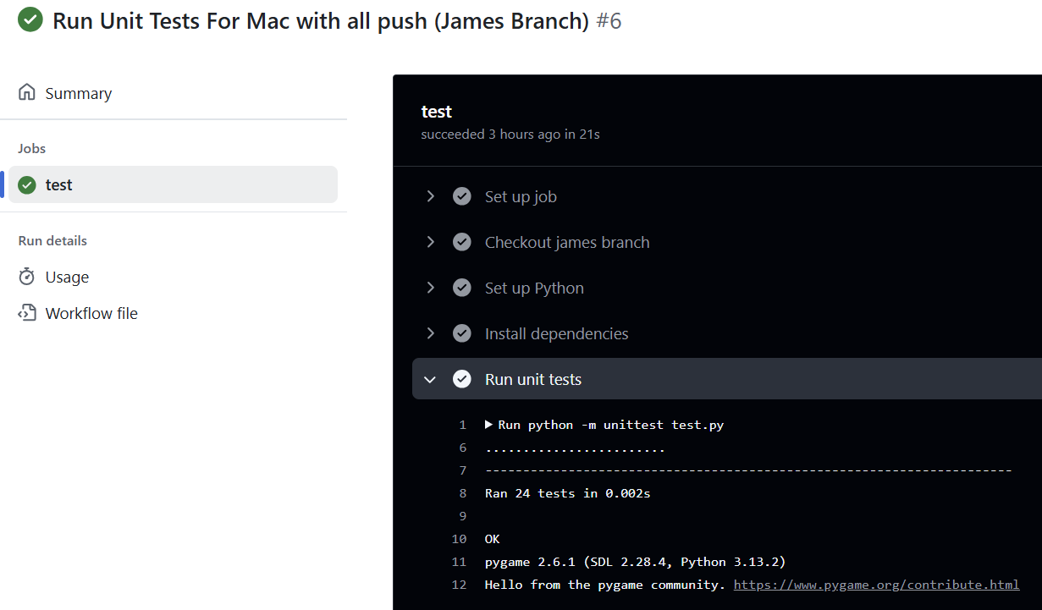
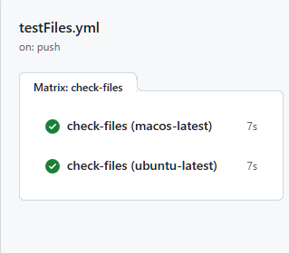
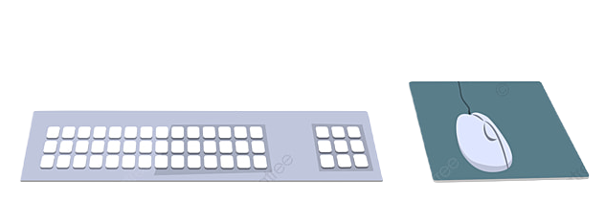
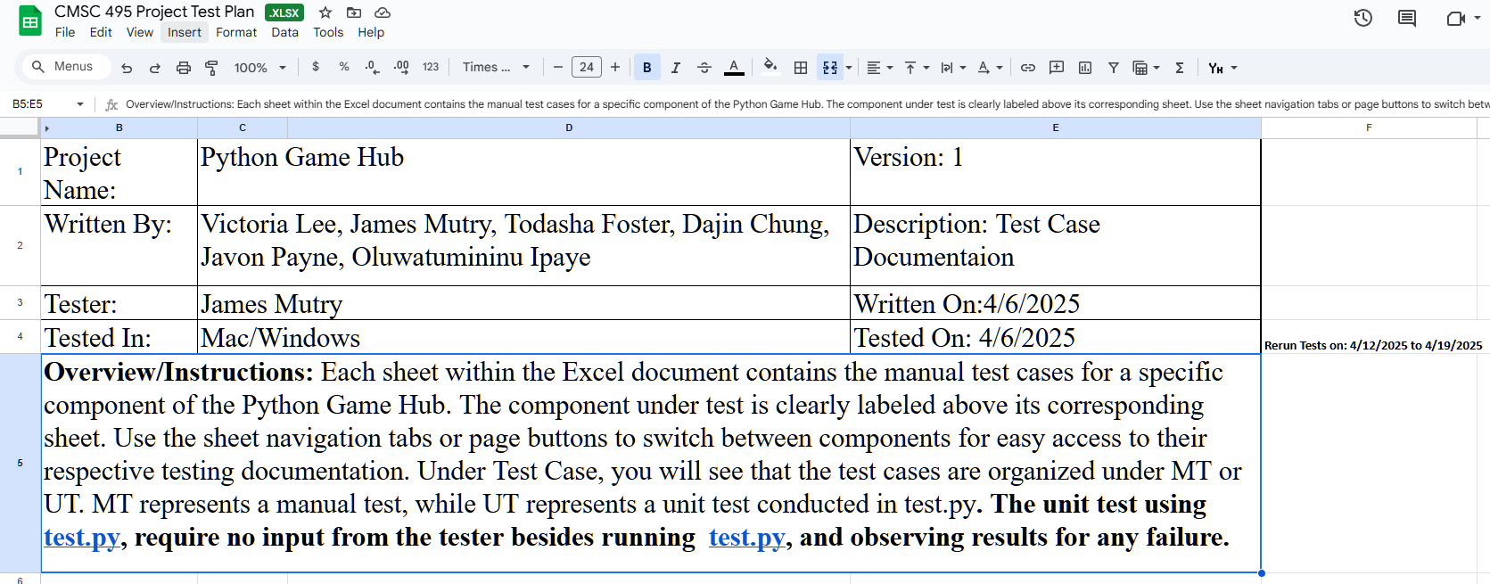
Project Evaluation, Test Plan, and Results:
Finalized manual and automated test plans (includes GitHub Actions),
we were able to identify and fix all major issues before deployment and passed the tests.
Unit 4: Phase 1 Source Report Plan
Tests: 13 unit tests (old test.py, main branch) – no GitHub Actions.
Overview: Covers early development and core game implementations (Mainmenu, TicTacToe, Breakout, Trivia).
[Google Drive (Docx) Link]
[GitHub (doc) Link]
Unit 5: Testing Plan
Tests: 20 manual test cases (Excel), 24 unit tests (new test.py, James branch), 6 GitHub Actions.
Overview: Full validation of features and behavior, including Trivia.py and Questions.json accuracy.
[Google Drive (Docx) Link]
[GitHub (doc) Link]
Unit 6: Phase 2 Source Report Plan
Tests: Same as Unit 5, plus 2 GitHub Actions to verify all core files exist for deployment.
Overview: Final features, bug fixes, test reruns, and full documentation (README, comments).
[Google Drive (Docx) Link]
[GitHub (doc) Link]
Unit 7: User Guide
Overview: End-user instructions for setup and gameplay. Includes game rules, navigation, and GitHub links.
[Google Drive (Docx) Link]
[GitHub (doc) Link]
Unit 8: Deployment Report
Overview: Final packaging of all files, documentation, and submission materials. Includes peer review prep.
Presentation: Google Slides video/ppt summarizing all phases and key outcomes.
[Google Drive (Docx) Link]
[GitHub (doc) Link] (Check it at the GitHub repository doc folder!)
[Google Slides Link] (Check it at the GitHub repository doc folder or the Unit 8 discussion!) [PythonGameHub GitHub Repo Link]
Notes:
Now, in this slide I’ll discuss the project evaluation, test plans, verification, and results. By doing the GUI and back-end code using detailed manual and automated test plans including GitHub Actions, we were able to identify and fix all major issues before deployment. All of the test plan documents and results for Units 4, 5, and 6 ensures that our Python Game Hub project works and is ready for deployment. These testings allowed us to identify and resolve issues for the final production or deployment process. In Units 4, 5, and 6 we were able to successfully identify and fix all problems while testing it continuously until every test case has passed without any fails. You can learn how to run these tests again using the Unit 7 User guide and the Unit 8 README.md file. The finalized test plans, including both manual and automated testing (unit tests and github actions), have been embedded in this document and can be opened by clicking on their links below.
There are two links the Google Drive one and the GitHub doc folder. Both links should work.
Images to the right demonstrate the Unittest ran through the GitHub Actions or IDE and the Manual Excel testing.

Slide 8
Design and Alternate Designs:
Our Python Game Hub followed a modular, object-oriented design using the Waterfall model.
Phase 1 established the core architecture—Main Menu, Tic-Tac-Toe, Trivia, and Breakout—along with early unit tests and GitHub version control.
Phase 2 finalized the application with 24+ unit tests, GitHub Actions CI/CD, full manual testing, and optimized gameplay and UI.
All features were validated for performance, usability, and reliability.
Phase 1 Report Phase 2 Report

Slide 9
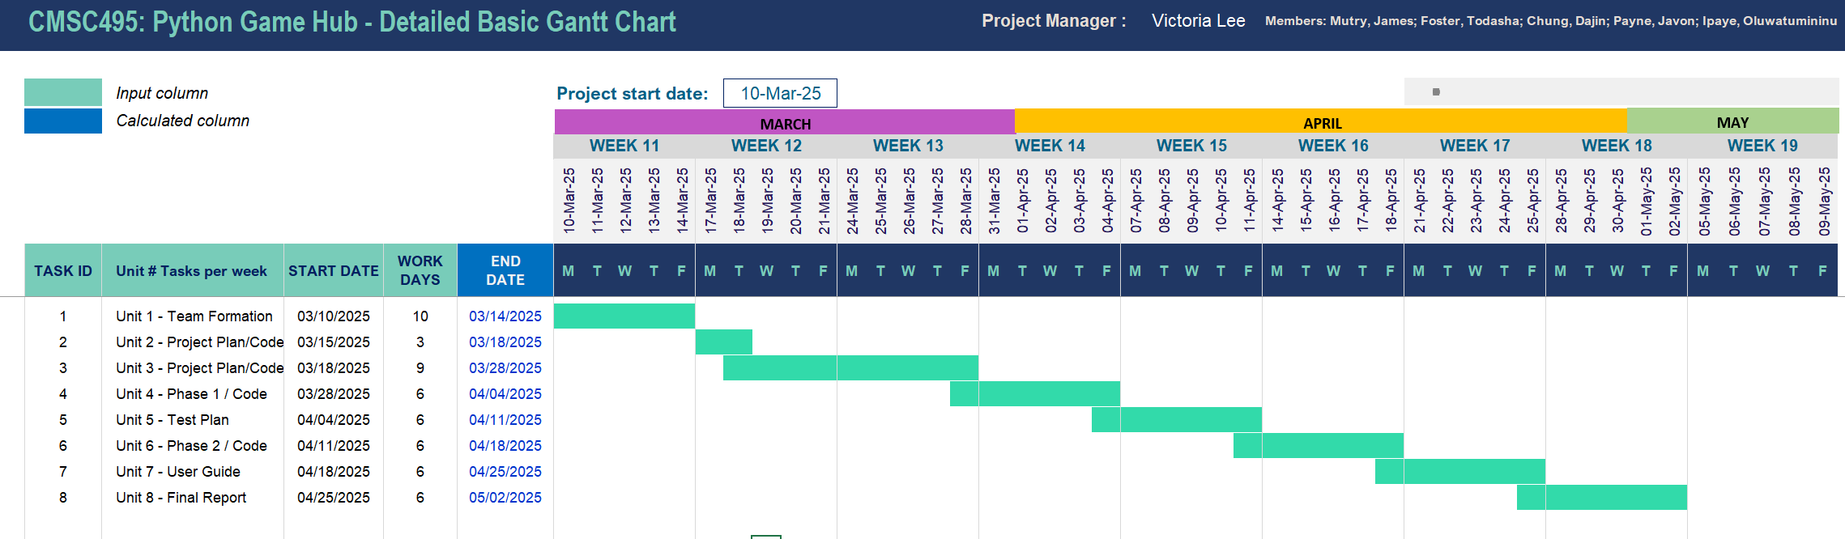
Project timeline Image 1
Notes:
For the Project Timeline, here is our Project Timeline based on Unit 4 and 5 after feedback on our Project Plans.
By following the SDLC waterfall method, this is a Gantt chart of the timeline for our project.
You can notice that we had to update this chart during unit 4 and unit 5 as we delayed the due date for unit 3. The new chart which is shown above demonstrates per unit is about 7 days.
Please disregard the Workdays counter as my math equation makes mistakes as It doesn’t count SAT/Sun and holidays. To mitigate this, I had to change the equation, but it messed up the work days counter. The Start and End dates are 100% correct.

Slide 10
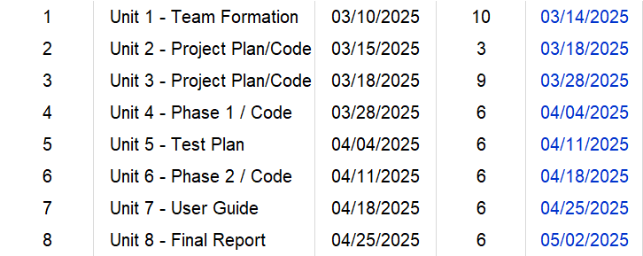
Development History (Project Timeline) and Deployment:
Project Timeline (based on updates[Phases 1 & 2]):
Unit 2: Project Plan
[Google Drive (Docx) Link]
[GitHub (doc) Link]
Unit 3: Project Design Plan
[Google Drive (Docx) Link]
[GitHub (doc) Link]
Unit 4: Phase 1 Source Report Plan
[Google Drive (Docx) Link]
[GitHub (doc) Link]
Unit 5: Testing Plan
[Google Drive (Docx) Link]
[GitHub (doc) Link]
Unit 6: Phase 2 Source Report Plan
[Google Drive (Docx) Link]
[GitHub (doc) Link]
Unit 7: User Guide
[Google Drive (Docx) Link]
[GitHub (doc) Link]
Unit 8: Deployment Report
[Google Drive (Docx) Link]
[GitHub (doc) Link][Google Slides Link]
(Refer to GitHub Repo for those links)
[PythonGameHub GitHub Repo Link]
Timeline for Project:
⚠️Python Game Hub must be Publicly Accessed on GitHub:
GitHub Repository:
[CMSC495Capstone-Python Game Hub]
Read the README.md OR User Guide
Notes:
Now, continuing the Project Timeline, development history, and deployment. Here is the breakdown of our documentation, updates, and completed tasks per Unit. It goes from Units 1- 8.
Starting from the first three weeks, the Project Plan and Design Plan were essential in our Python Game Hub project as they provided a clear roadmap and structure, helping the team stay organized, meet deadlines, and ensure all features were well thought out before coding began. Next, in the fourth and sixth weeks, the development phases (Phase 1 and Phase 2) ensured all core and advanced features were implemented and refined. On week 5 for the Testing plan, it confirmed that all games worked on all platforms (Windows, Mac, and Linux), while the User Guide for Unit 7 made the project accessible for users and the “getting started steps”. Finally, during Unit 8, the Deployment Report and Presentation ensured everything was ready for final submission. The links are attached here and it should have both the Google Drive link and GitHub doc folder link.
To display our deployment, we have made it so that our
Python Game Hub must be Publicly Accessed on GitHub:
GitHub Repository:
You can access it with the link given below and follow the isnructions on the readme.md file or the User guide to get started!
[CMSC495Capstone-Python Game Hub]
Read the README.md OR User Guide

Slide 11
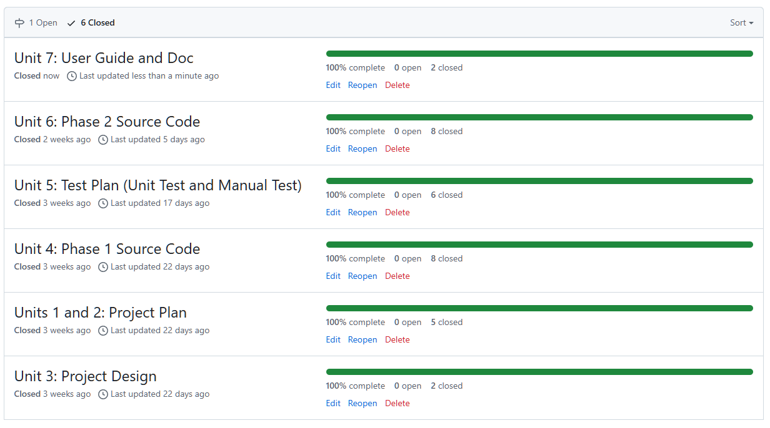
Project timeline Expansion Explanation
Refer to Unit 4, Unit 6, and Unit 8 to compare the project timelines, job contributions, Git (Version Control), Testing, and Changes to the Project Management sections.
Unit 6: Phase 2 Source Report Plan
[Google Drive (Docx) Link]
[GitHub (doc) Link]
Unit 7: User Guide
[Google Drive (Docx) Link]
[GitHub (doc) Link]
Unit 8: Deployment Report
[Google Drive (Docx) Link]
[GitHub (doc) Link and Slides]
(At GitHub repository “doc”)
[PythonGameHub GitHub Repo Link]
It is crucial to view the APPENDIX sections:
The testing and Git version control processes are further detailed in APPENDIX D and APPENDIX E. The Milestones and Gantt chart updates with the Contribution Report are in APPENDIX A, APPENDIX B, and APPENDIX E.
A shows the overall timeline due dates and how our progress compares with units 1-8. B shows the breakdown of each task/milestones completed and costs.
APPENDIX C is referring to the delays and emergencies so far to push back the code.
APPENDIX E shows the breakdown of the Git issues/milestones completed for that week (screenshots).
Figure: This image below represents the project timeline plans for our team using the SDLC waterfall method
Notes:
Continuing on from the previous slide, please Refer to Unit 6, and Unit 8 to compare the project timelines, job contributions, Git (Version Control), Testing, and Changes to the Project Management sections. By going to these documents, you can see all core and advanced features were implemented and refined, including the testings that passed without failure. Meanwhile, the Deployment Report and Presentation ensured everything was ready, reviewed, and clearly communicated for final submission including all links to each section. When checking units 6 and 8 you must go the all the APPENDIXES sections.
The testing and Git version control processes are further detailed in APPENDIX D and APPENDIX E. The Milestones and Gantt chart updates with the Contribution Report are in APPENDIX A, APPENDIX B, and APPENDIX E.
A shows the overall timeline due dates and how our progress compares with units 1-8. B shows the breakdown of each task/milestones completed and costs.
APPENDIX C is referring to the delays and emergencies so far to push back the code.
APPENDIX E shows the breakdown of the Git issues/milestones completed for that week (screenshots).
Lastly, Unit 7 is more on the design/overall application overview.

Slide 12

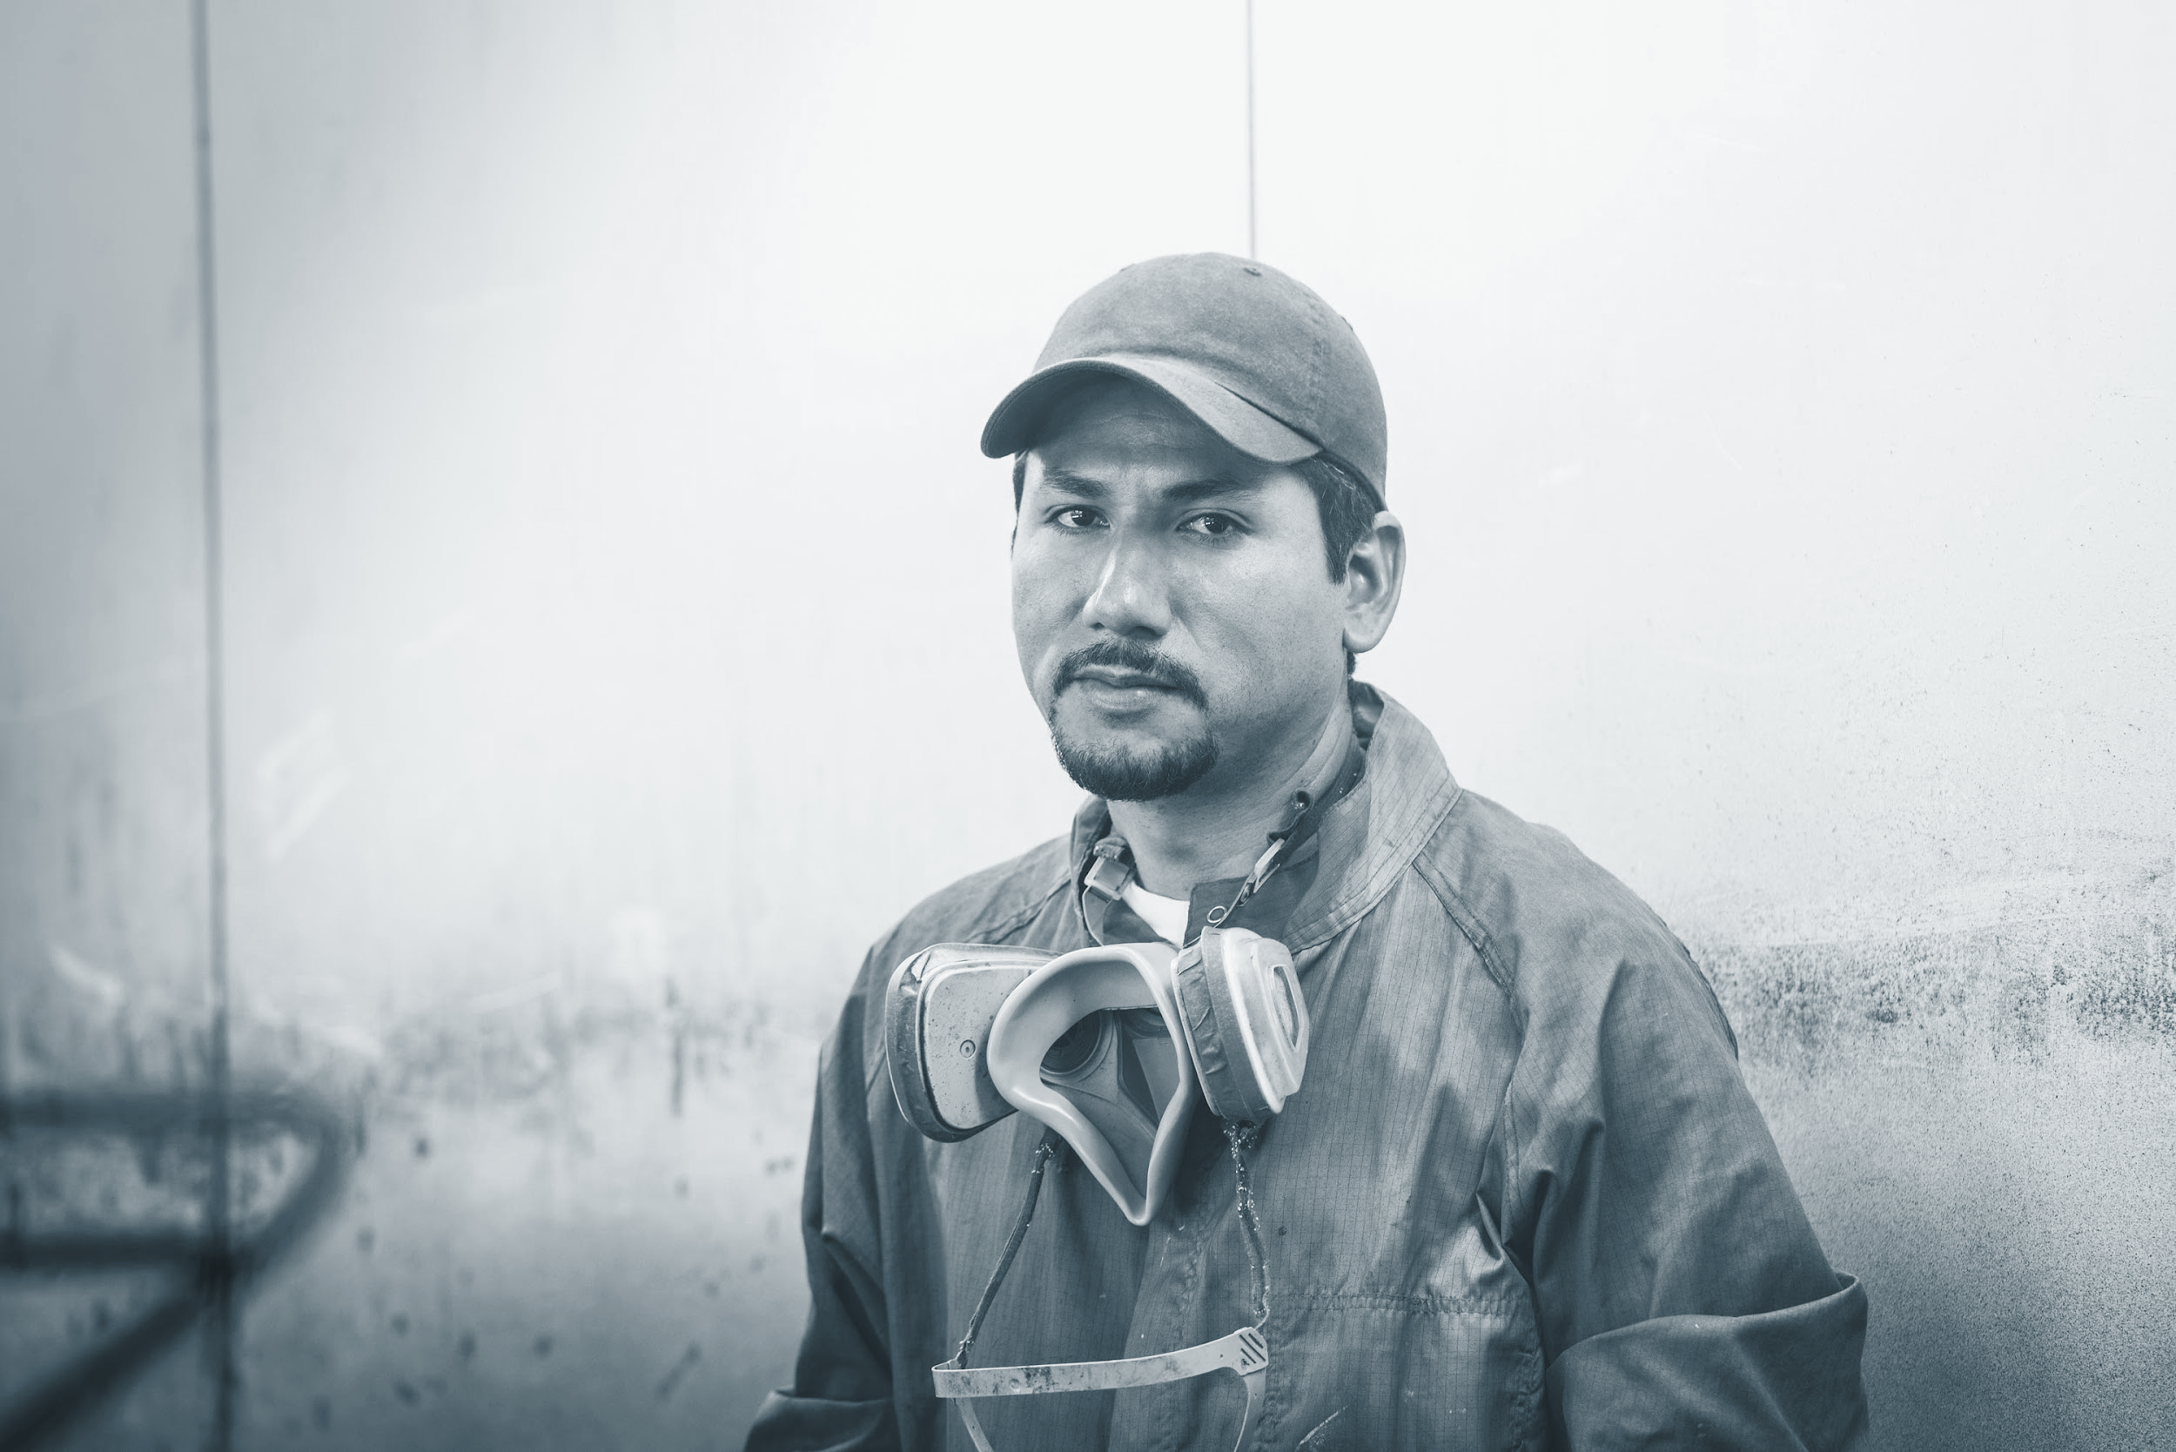

Discussion
Throughout this project, we learned the value of strong modular design, clear documentation, and regular testing. One of our strengths was creating a smooth and unified player experience across different games.
However, some limitations included challenges with cross-platform testing and limited mobile compatibility.
For the future, we suggest adding database support, expanding automated testing, and improving UI responsiveness. Overall, this project taught us that solid planning, communication, and teamwork are essential to delivering a polished and maintainable software product.

Slide 13
Conclusion
• Successfully delivered a modular Python game hub with three mini-games
• Followed the SDLC Waterfall Model across eight project units
• Combined automated and manual testing to ensure a bug-free deployment
• Used GitHub for version control and implemented CI/CD via GitHub Actions
• Learned collaboration, version control, task ownership, and technical writing
• Ready for public GitHub release and future scalability

Slide 14
Acknowledgements
Victoria Lee (GitHub: VictoriaRaven): As a Project Manager / Technical Writer / Tester (GitHub Actions / Repo), I want to express my deepest gratitude to my amazing team for their unwavering dedication and hard work throughout this project. The way we came together, blending our skills, strengths, commitment,and teamwork like in the Avengers, Marvel movie, made this experience truly special (Whedon, 2012). I also want to extend a heartfelt thank you to my peers and family, whose suggestions helped shape the final product. Your support, both on and off the project, was invaluable and truly appreciated. Thank you and as always, “Not all treasure is silver and gold, mate.” -Captain Jack Sparrow (Pirates of the Caribbean) (Verbinski, 2003).
James Mutry (GitHub: jamesmutry): As a Technical Writer / Tester (Unit Tests & Manual Tests), I would like to take this opportunity to sincerely thank my entire team for their dedication, hard work, and collaboration throughout the Python Game Hub project. Each member brought their own unique skills and strengths, contributing to the success of this challenging and rewarding experience. From initial planning to final deployment, our team consistently supported one another, tackled obstacles together, and maintained a strong commitment to producing a polished and functional final product. I am especially grateful for the positive attitude, adaptability, and professionalism that everyone demonstrated during each phase of the project. Working alongside such a talented and motivated group made this capstone experience not only educational but truly enjoyable. I am proud of what we accomplished together and thankful to have had the opportunity to collaborate with such an outstanding team.
Javon Payne (GitHub: javonpayne100): As a Git Lead (.py files) / Developer (MainMenu & Trivia) / Sub Tester), I want to give a huge thanks to my team for bringing me on board with open arms. It’s a blessing to have a team with diverse skills, restless drive, and great character. This experience has definitely taught me a lot and this type of camaraderie should be the standard of many development teams. I want to especially thank Victoria; her organization skills and leadership is unmatched. Congratulations everyone, graduation is here! “May the force be with you.” - Yoda

Slide 15
Acknowledgements (Continued)
Todasha Foster (GitHub: DayFoster123): As a Developer (Breakout) / Sub Tester, I would like to express my sincere appreciation to my team members for their energy, creativity, and collaboration throughout this project. Contributing as a developer was a rewarding experience that allowed me to strengthen my skills and grow professionally. I am proud of the challenges we overcame together and the final products we created. This achievement reflects the passion, effort, and dedication of every member of the team. "I never dreamed about success. I worked for it." – Estée Lauder
Dajin Chung (GitHub: dajinchung): As a Developer (TicTacToe) / Sub Tester, I’d like to thank my entire team for their hard work and collaboration throughout this project. Each member contributed their strengths, from development and testing to design and documentation, to bring this project to life. A special thanks to Victoria, who truly stepped up as project manager. Her organization, communication, and consistent support helped keep our team focused and on track. We would not have reached this level of polish and completion without her leadership. Everybody, thank you for all your hard work. As a wise ogre once said, “That’ll do Donkey. That’ll do.” - Shrek
Oluwatumininu Ipaye (GitHub: tumiwiththewave): As a Developer (Breakout) / Sub Tester, I want to express my deepest gratitude to the entire team for their hard work and resilience to get this project done. I have been able to learn a lot from each single member and effectively learnt how to work in a group setting such as this. My skills have been boosted and challenged at the same time, which shows that being a coder/programmer is a never ending lesson. I would like to specially thank Victoria Lee, as she was the backbone of this entire project and ensured everything went smoothly and without any hitches. I am proud of what we were able to accomplish in a short period, and wish you all the best ahead. The sky’s the limit.
Notes:
No audio as it continues off the transition slide from the previous!

Slide 16
References (Key parts only)
Amazon Web Services. (n.d.). What is unit testing? Amazon Web Services, Inc. https://aws.amazon.com/what-is/unit-testing/
Doe, J., & Lee, A. (2020). Creating effective contribution reports in software projects: Guidelines and strategies. IEEE Software Engineering Journal, 45(6), 102–115. https://doi.org/10.1109/SEJ.2020.3082548
Erickson, J. (n.d.). Algorithms. University of Illinois at Urbana-Champaign. Online textbook available.
GeeksforGeeks. (n.d.). Software Development Life Cycle (SDLC). https://www.geeksforgeeks.org/software-development-life-cycle-sdlc/
GeeksforGeeks. (2024). Object-Oriented Design (OOP). https://www.geeksforgeeks.org/oops-object-oriented-design/
GeeksforGeeks. (2024). What is a Project Plan. https://www.geeksforgeeks.org/project-plan/
LeetCode. (n.d.). LeetCode - The world's leading online programming learning platform. LeetCode. Retrieved April 12, 2025, from https://leetcode.com/
Liang, Y. D. (2023, May 23). Introduction to Java programming and data structures (13th ed.). Pearson. Online textbook available. (n.d.)
Mount, D. (n.d.). Algorithms [Lectures CMSC 251]. University of Maryland Global Campus.
Nievergelt, J. (n.d.). Algorithms and data structures. University of Maryland Global Campus.
Stellman, A., & Greene, J. (2005). Software project planning. In Applied software project management (Part I, Chapters 5, 6, 8, 9, 10, 11). O'Reilly Media. https://go.oreilly.com/umgc/https://learning.oreilly.com/library/view/applied-software-project/0596009488/ch08.html
Sweigart, A. (n.d.). Making games with Python & Pygame. https://inventwithpython.com/makinggames.pdf
Tsui, F., Karam, O., & Bernal, B. (2014). Essentials of software engineering (3rd ed.). Jones and Bartlett Learning. https://library-books24x7-com.ezproxy.umgc.edu/toc.aspx?site=VGX8U&bookID=51648
Winters, T., Manshreck, T., & Wright, H. (2020). Software engineering at Google (Chs. 18–19). O'Reilly Media. https://learning.oreilly.com/library/view/software-engineering-at/9781492082781/ch18.html
Unit 8: Deployment Report
[Google Drive (Docx) Link]
[GitHub (doc) Link] (Check it at the GitHub repository doc folder!)
[Google Slides Link] (Check it at the GitHub repository doc folder or the Unit 8 discussion!)
[PythonGameHub GitHub Repo Link]

Slide 17
Appendix
Unit 8: Deployment Report
[Google Drive (Docx) Link]
[GitHub (doc) Link] (Check it at the GitHub repository doc folder!)
[Google Slides Link] (Check it at the GitHub repository doc folder or the Unit 8 discussion!)
[PythonGameHub GitHub Repo Link]
-Thank you!

